Slide 1
Agile Development
Topic 9:
Requirements Definition and Prioritisation
Notes:
NCC Education - Title Master

Slide 2
Topic 9 Coverage
This topic will cover:
  What is a requirement?
  Defining the requirements;
  Requirements in the Agile approach lifecycle;
  Requirements and modelling;
  The Requirement Lifecycle.
Notes:
Requirements are at the center of all Agile projects. It is important that you understand their importance, and how to define them effectively to ensure successful project outcomes.

Slide 3

Group Exercise: What is a Requirement?
List as many words or phrases as you can that mean “requirement”.
Source: Image from pixabay.com © 2016
Notes:
DSDM ATERN
Approach and Principles
ATERN S1 Approach
Class Exercise:
The purpose of this exercise is to show students that a requirement can be many things, both positive and negative. Typical results may include:
Positives: Wish; Want; Must Have; Desire; Need; Legal Obligation; Social Responsibility.
Negatives may include: Something we don’t want, or we want to prevent; Constraint; Restriction;

Slide 4
What is a Requirement?
  In simple terms, a requirement is a feature, a function, a service or a constraint. For example, requirements can mean the following:
  Feature/Function – element of the planned product
  Service – a service the project needs to ensure it delivers
  Constraint – something that will act as a barrier during the project that needs to be planned for and suitable work arounds achieved.
Notes:
The class exercise would’ve highlighted most, if not all. Take this opportunity to highlight the difference;
Feature/Function – element of the planned product
Service – a service the project needs to ensure it delivers
Constraint – something that will act as a barrier during the project that needs to be planned for and suitable work arounds achieved.

Slide 5
Defining the Requirements
  It is important to define a requirement along with its acceptance criteria as measurable targets at all levels. It is vital to give each requirement a unique ID, and keep the following details: Source; Owner; Business Benefit; and Priority.
Notes:
Consider:
As a …I need … in order to …
Each requirement should be given a unique ID. Highlight to students that they should not renumber requirements once they are given these unique numbers; it causes confusion and we need traceability of requirements through from capture to implementation or rejection.
We define the what rather than the how for functional requirements. This allows flexibility for the team to implement the best solution within the time they have.
Non-functional requirements must not be missed. These are the measures of performance: how well the system must perform to be acceptable.
Each requirement needs acceptance criteria to make it clear what constitutes success i.e. so that the team knows when the job is “done”.
DSDM ATERN
Requirements Definition and Prioritisation
ATERN S5reqdef

Slide 6
Functional Requirements
  Functional requirement is “what”, not “how”. It is important to make a requirement SMART: Specific; Measurable; Achievable; Realistic and Timely.
  It is also important to consider the wording of a functional requirement. For example, “We need the ability to …” or “As a … I need… in order to …”.
  Functional requirements should not be in conflict with, or overlap, with other requirements.
Notes:
The format for a requirement as “AS a ....I Need ... In order to.... This format is the User Story, and is a fundamental concept of Agile. The method espouses the idea of the user story. Hence, the private study work after this session allows the student to research this further. Here, you should highlight this format and give a few examples of requirements expressed in this form.
A User Story is a piece of functionality that will be valuable to either a user or purchaser. It comprises:
A written description
Later conversations fleshing out the details of the story
Acceptance criteria and tests to determine when the story has been satisfied within the project.
It is of the format:
As a (user or purchaser)
I need (the valuable piece of functionality)
So that (I can achieve something valuable)
For example: As a Receptionist, I need to be able to identify vacant rooms for a date, so that I can sell those rooms and dates to a customer
User stories can be at many levels (like the hierarchy of traditional requirements), from an Epic level (the objective of the project) down to really detailed pieces of functionality. It is also possible to express non-functional requirements as user stories.
Additional material on this can be derived from Mike Cohn’s book if required (Cohn, M. (2004) User Stories Applied: For Agile Software Development. Pearson Addison Wesley.)

Slide 7
Group Exercise: Functional Requirements
In small groups, consider the requirement; “set up a personal bank account”, Create some SMART requirements based on this from the perspectives of:
    The customer
    The bank manager
Notes:
This exercise should provide students with the opportunity to discuss functional requirements from differing perspectives. If time permits, more practice can be given with further examples relevant to the group, such as:
“As a student I need the Agile Development Diploma so that I can ......”

Slide 8
Non-Functional Requirements – 1
Non-functional requirements are about “how well” we do the functional requirements. They are features that ensure a finished products work effectively and fits in well with the company brand, such as:
  Security
  Availability
  Portability
  Maintainability
Notes:
Non-functional requirements are of equal importance, they are the things that ensure the finished product not only works effectively, but that it fits within the company brand and is ‘future fit’.
Things like ensuring the system is secure, is user friendly and works within expected response times. They will relate to at least one functional require, but can relate to more than one or some will relate to all (global) functional requirements.

Slide 9
Non-Functional Requirements – 2
  External interfaces
  Design constraints
  Performance
  Response time
They may be global or related to just one functional requirement. It is likely that they will require extra time in the plan.

Slide 10
Structure of Requirements – 1
  Requirement Decomposition
  Feasibility – A very high level set of requirements is established.
  Foundations – A high level set of prioritised requirements is established (a PRL) and User stories.
Notes:
Requirements will be addressed at various stages throughout the life cycle of an Agile project.
This begins with a high level of requirements being established during the feasibility stage.
These requirements will be refined and will prioritised during the foundations stage, and will be refined further into a more detailed set of requirements during the exploration and engineering stage.
It is possible that some decomposition may not be formalised on paper, but will evolve during the exploration and engineering stage during development.
Prototyping is likely to capture these evolving requirements.

Slide 11
Structure of Requirements – 2
  Exploration and Engineering – Each requirement may decompose into more detailed requirements, and, at some point, it may not need to be written down, but evolved as part of iterative development (prototyping).

Slide 12
Requirements and Modelling
Handle
Reservations
R1
M
Make a reservation
R1.1
M
R1.2
Make a conference
booking
W
Amend a reservation
S
Make an individual booking
R1.1.1
M
Cancel a reservation
R1.1.2
M
R1.1.3
Produce occupancy report
C
Notes:
Each requirement will be broken down and modelling is a good way to show requirements and their sub-requirements. Here we are looking at a high level requirement ‘Handle reservations’, and this requirement is then broken down into sub-requirements such as ‘Make a reservation’ and further still to sub-requirements of this function such as ‘Make a conference booking’ or Make an individual booking’

Slide 13
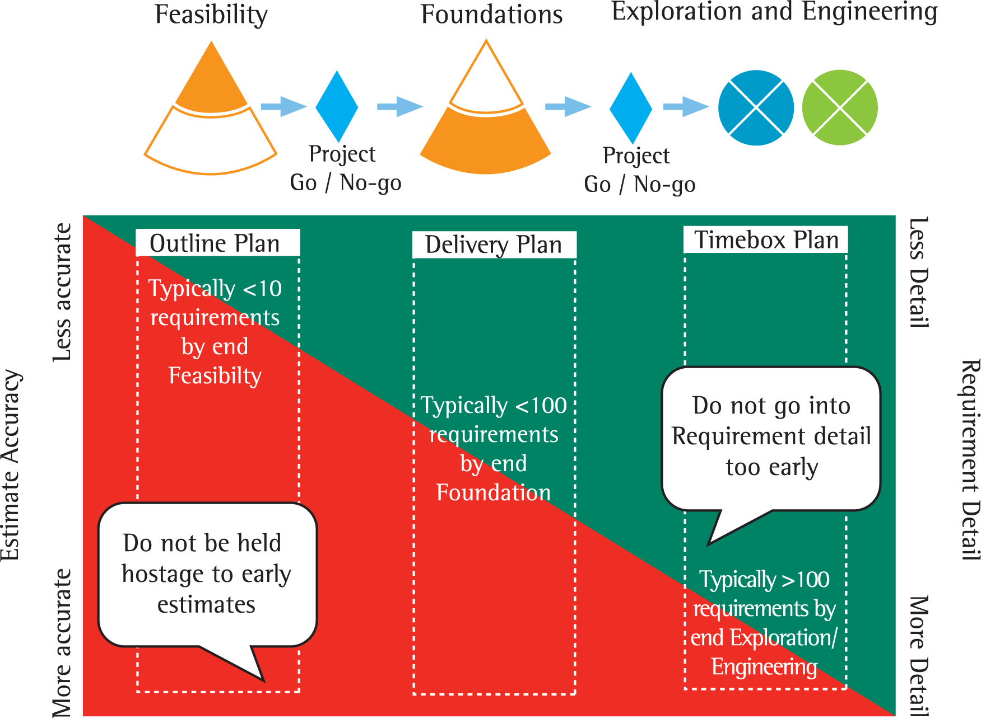
Requirements in the DSDM Lifecycle
Less
Less
Outline
Plan
Delivery
Plan
Timebox
Plan(s)
Estimate
Accuracy
Typically <10
requirements
Requirement
Detail
Typically <100
requirements
Do not be held hostage to early estimates
Typically >100
requirements
More
More
Source: Image from pixabay.com © 2016
Notes:
Here you can see how the level of detail for each requirement increases throughout the life cycle. With less requirements and detail necessary during the feasibility stage through to many requirements with much greater detail included during the exploration and engineering stage.
DSDM ATERN
Prototyping, Timeboxing and Estimating
ATERN S7 Prototyping TimeboxandEst

Slide 14
What is MoSCoW? – 1
  Must haves are:
    Fundamental to system;
    Without them, system unworkable/useless;
    Minimum usable subset;
    Guaranteed to be developed.
Notes:
DSDM uses the MoSCoW prioritisation model.
Concentrating approximately 60% of the project on the ‘Must Have’ requirements, and around 20% on the ‘Could Have’ requirements.

Slide 15
What is MoSCoW? – 2
  Should haves include:
    Important requirements;
    Would be mandatory, but workaround exists;
    System will still be useful/usable without them.

Slide 16
What is MoSCoW? – 3
  Could haves would add business benefit and are more easily left out of this increment than Should Haves. Won’t haves can be valuable requirements but can wait until a later increment.
  Note: All prioritisation is with respect to a clear project objective.
Notes:
Prioritisation in DSDM is about balancing risk and predictability of project outcomes. At no stage though should the ‘Should Have’ or ‘Could Have’ requirements take precedence over the ‘Must Have’ requirements.

Slide 17
Group Exercise: Identifying requirements
Get into groups of approximately 4. Revisit the exercise from Topic 6 where you listed 20 features your need in a house. Identify the functional and non-functional requirements, and then prioritise them using MoSCoW.
Notes:
Class Exercise:
This is a reprise of the exercise in Topic 6 which looked at the requirements for a house. If preferred, a new exercise could be used to identify 20 requirements for a mobile phone, a job, or a holiday. Students should work in groups of approximately 4. These can then be used to explore the types of requirements which have emerged: Functional and Non-functional.
The Non-functional requirements can then be elaborated further by asking:
Any security requirements?
Any availability requirements?
Any performance requirements?
The students should then prioritise the requirements: M, S, C and possibly some Won’t Haves.
You should then discuss these prioritisations, using questions such as:
How many Must Haves are there? Is that too many
What is the worst that would happen if that Must Have was not delivered within 3 months? Within 6 months?
How do we distinguish a Should Have from a Could Have?
DSDM ATERN
Modelling
ATERN S2 modelling

Slide 18
The Requirement Lifecycle
  Each requirement must be subject to:
  Elicitation – Workshops, model-building, interviews, observation, scenarios.
  Analysis – Realistic? Ambiguous? Combination of requirements? Aligned with business?
  Validation – Prototypes, reviews, models, testing.
  Management – Traceability, stability, change management.
Notes:
Requirements can be captured in many ways, including workshops. However, more work needs to be done to ensure requirements are complete, consistent and not conflicting. The Business Analyst brings skills to the team to ensure good requirements definition, analysis and validation and management through the lifecycle.

Slide 19
Summary – 1
What is a requirement?
  A function, feature, service or constraint
Functional and non-functional requirements
  Functional = what not how
  Non-Functional = how well
Requirements in the DSDM lifecycle
  Requirements increase in number and detail throughout the lifecycle
Notes:
A summary of the content covered in this topic is provided on this slide. Go through the points with the students and check their understanding of each one.

Slide 20
Summary – 2
Requirements and modelling
  Requirements are broken down and demonstrated during modelling
The Requirement Lifecycle
  Elicitation/Analysis/Validation/Management

Slide 21
Topic 9 – Requirements Definition and Prioritisation
Any Questions?
Notes:
NCC Education - End Slide Master

